Slide 1
Introduction to VTK.js for OHIF

Slide 2



Acknowledgments
Presented By:
Forrest Li (Kitware)
Contributors:
Forrest Li (Kitware)
Trinity Urban (MGH and OHIF)
Steve Pieper (Isomics)
Erik Ziegler (OHIF)
Gordon J. Harris (MGH and OHIF)
James A. Petts (OHIF)
Danny Brown (OHIF)
Stephen Aylward (Kitware)

Slide 3
Funding Sources
VTK.js / Kitware
NIH NINDS R44NS081792
NIH NINDS R42NS086295
NIH NIBIB and NIGMS R01EB021396
NIH NIBIB R01EB014955
Isomics
NIH P41 EB015902
OHIF
NIH U24 CA199460

Slide 4

Course Goals
What can you do with vtk.js and OHIF
Developing with vtk.js
Learn about integrating vtk.js with OHIF
Learn how to develop your own vtk.js application

Slide 5
Course Outline
Introduction to vtk.js and OHIF (this video)
Starting a vtk.js project
vtk.js: Architecture, itk.js, widgets, and more
OHIF + vtk.js integration
Advanced vtk.js: WebGL and GLSL

Slide 6
Intended Audience
JavaScript proficiency
npm ecosystem and usage
ES6
Babel/webpack/etc. (preferred)
Medical image processing and visualization
Basics of medical image visualization
Understand purpose of volume rendering, slicing, transfer functions
Optional: Knowledge of C++ VTK and ITK

Slide 7
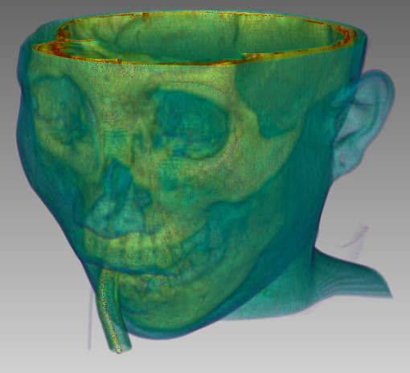
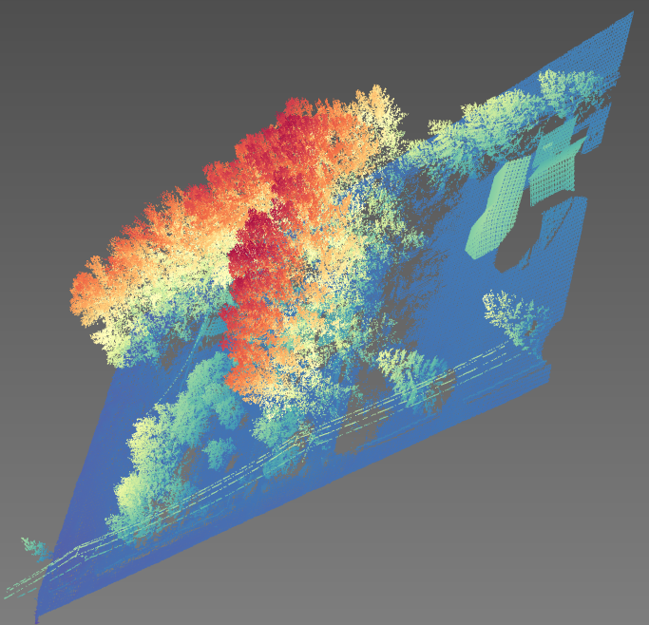
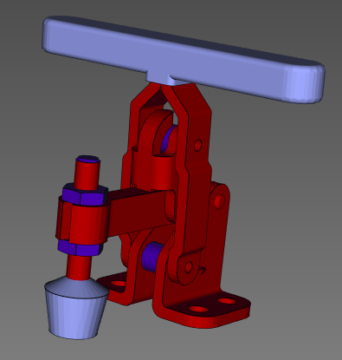
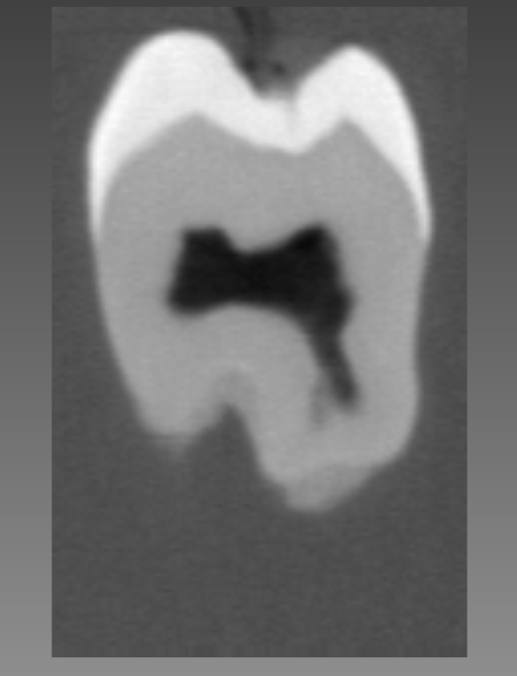
vtk.js
vtk.js is an open-source library for interactive 2D and 3D scientific data visualization and processing
Freely available for commercial and academic use
Volume rendering of images
Slice-based rendering of images
Surface renderings of geometry
Point cloud rendering
VR rendering...and more

Slide 8
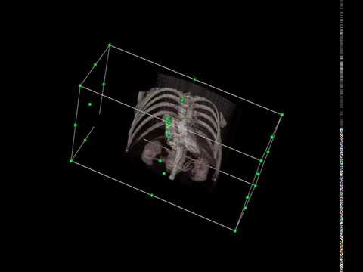
vtk.js
Interactive widgets and visualizations
Manipulate handles
Modify dataset visualizations
Architecture to build your own widgets
Extend or build from scratch

Slide 9
vtk.js
vtk.js is a rewrite of C++ VTK, for the web
Custom code for in-browser execution, supports all modern browsers and platforms
Advanced algorithms, workflows, interactive widgets (annotation, measurement, transfer functions)
vtk.js follows the core VTK architecture paradigm, but varies elsewhere
Different widget architecture
Filters, coding style, etc.

Slide 10
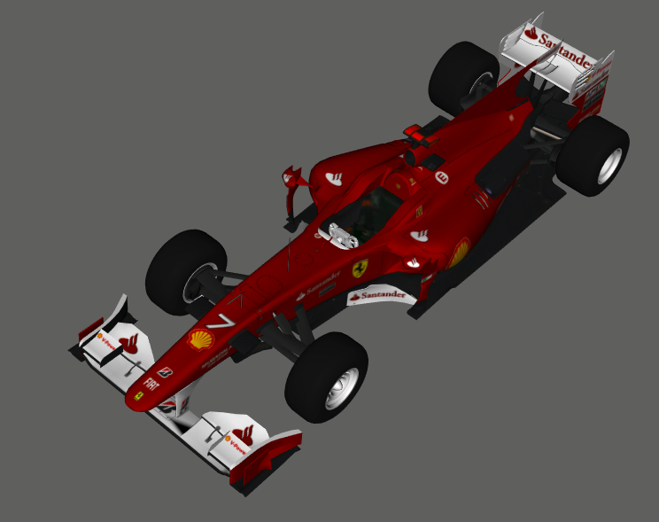
Why vtk.js?
Cross-platform portability via web browsers
“Zero-install” for users
Low-cost rapid deployment
Ease of data visualization
Flexible remote integration

Slide 11

Web Technologies behind vtk.js
WebGL: 3D graphics with GLSL
WebWorkers: Javascript background threads
WebVR: VR support
WebAssembly: super-fast in-browser processing

Slide 12
OHIF
Medical image viewing platform
Handles common application level problems
Authorization with OpenID Connect
Connect to popular and custom data sources
Robust extension and configuration support
Add panels, modals, and routes to support custom workflows
Define commands, toolbar buttons, and viewports to add powerful features
Maintained extensions for popular features
Whole slide microscopy viewing
Visualizing studies with Cornerstone or vtk.js
Advanced segmentation tools
Measurements list with labeling and descriptions
Notes:
Common level problems: - i18n - hotkeys Authorization: - Keycloack recipe - Google Cloud Healthcare API Data Sources - DICOMWeb (Orthanc, dcm4chee) - Custom JSON that maps data

Slide 13

More vtk.js examples
https://kitware.github.io/vtk-js
https://kitware.github.io/paraview-glance

Slide 14
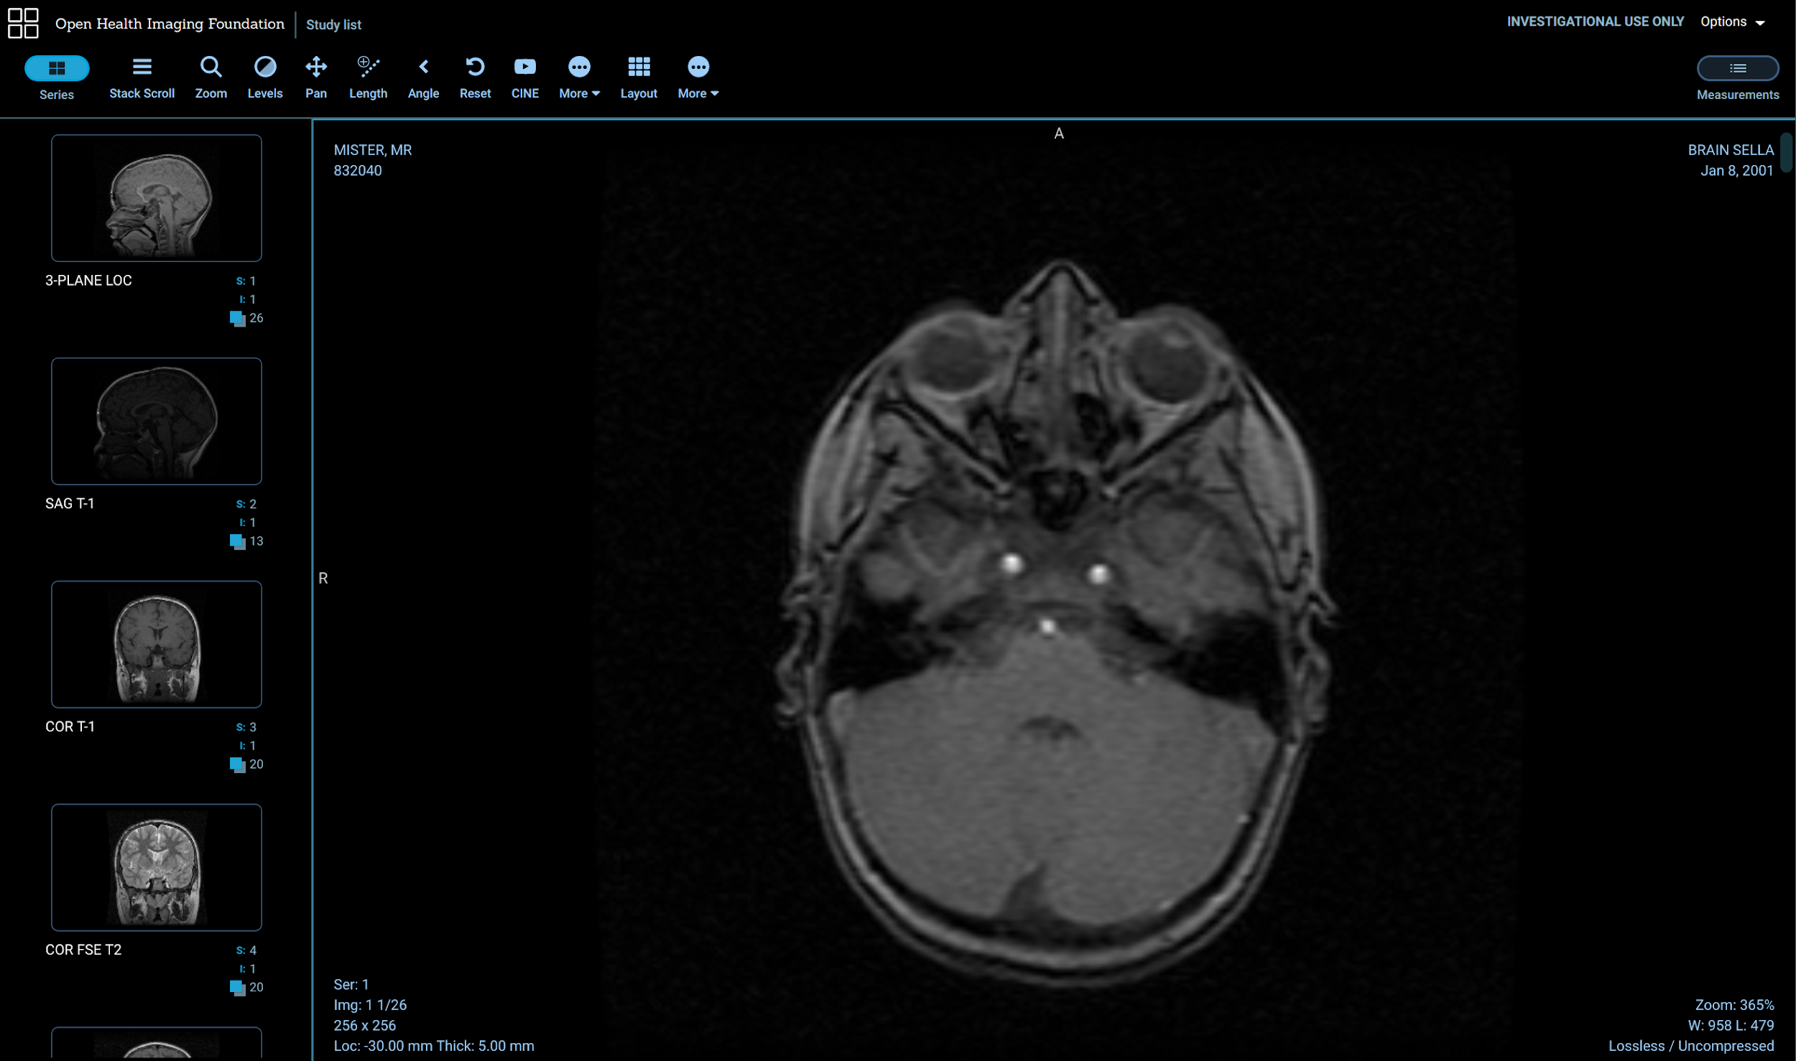
OHIF
https://viewer.ohif.org/

Slide 15
Next Time
Next course (#2):
Starting a vtk.js application

